Slide 1
Generative Adversarial Networks
Amol Patil
July 15, 2019

Slide 2
Overview
DNN Architecture Pioneered by Dr. Ian Goodfellow & his coworkers in 2014.
The ability to synthesize artificial samples (Images, Speech, Text, Videos) that are indistinguishable from real world is very exciting !!
“GANs is the most interesting idea in the last 10 years in Machine Learning” — Yann LeCun, Director of AI Research @Facebook AI.
It consists of two NNs (Generator and Discriminator) competing with each other until both networks are experts.
Notes:
Generative models allow a computer to create data — like photos, movies or music — by itself.
Build understanding of real world objects, Generate Stock Images, Entire Movie, Video Game, Music, New Fonts
Apple Hires The GANfather Ian Goodfellow Away From Google To Up Its ...

Slide 3
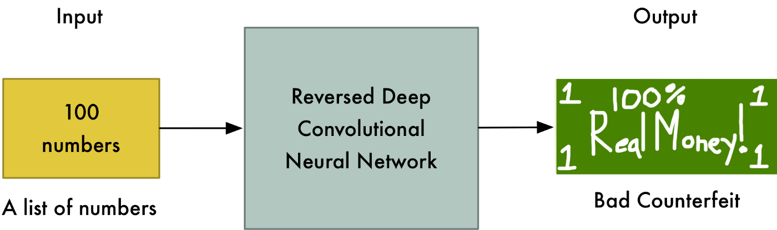
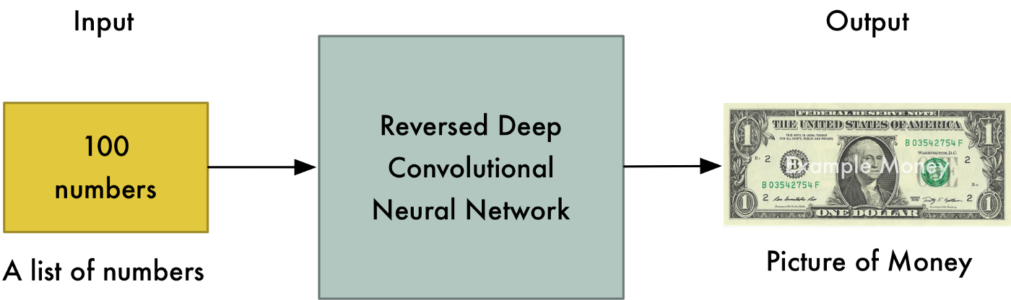
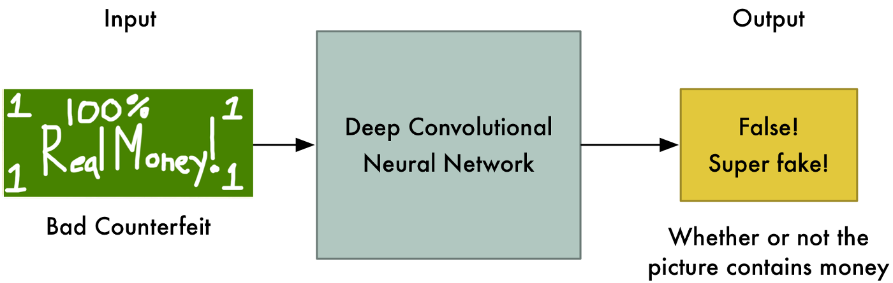
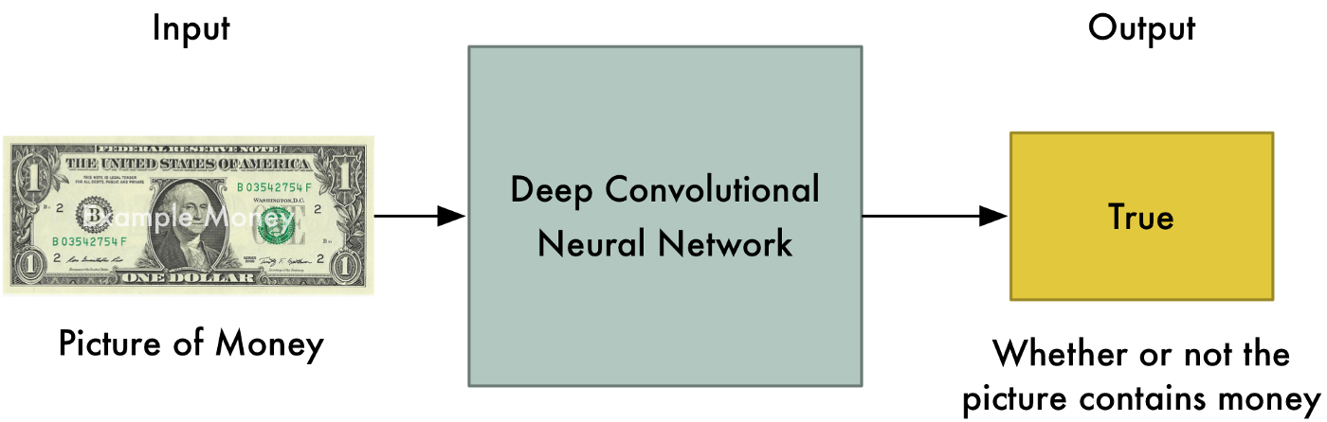
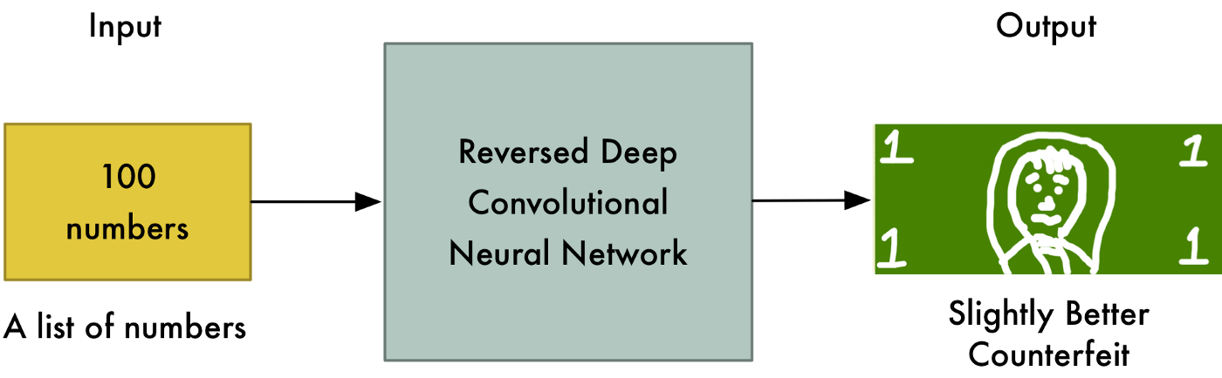
Generator & Discriminator Networks
Generator
Discriminator
https://medium.com/@ageitgey/abusing-generative-adversarial-networks-to-make-8-bit-pixel-art-e45d9b96cee7
Notes:
Printing Fake Notes - Counterfeiter (forgery) Gradient Ascent, Police Officer Gradient Descent
This back-and-forth game between the Generator and the Discriminator continues thousands of times until both networks are experts. Two adversaries are in constant battle throughout the training process

Slide 4
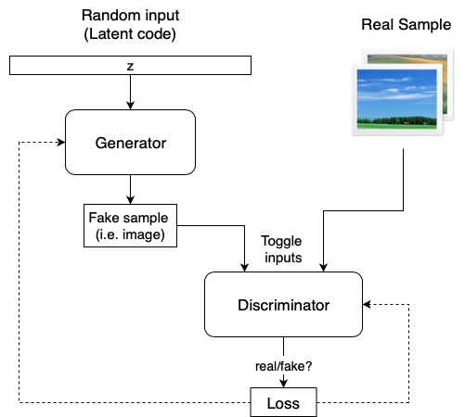
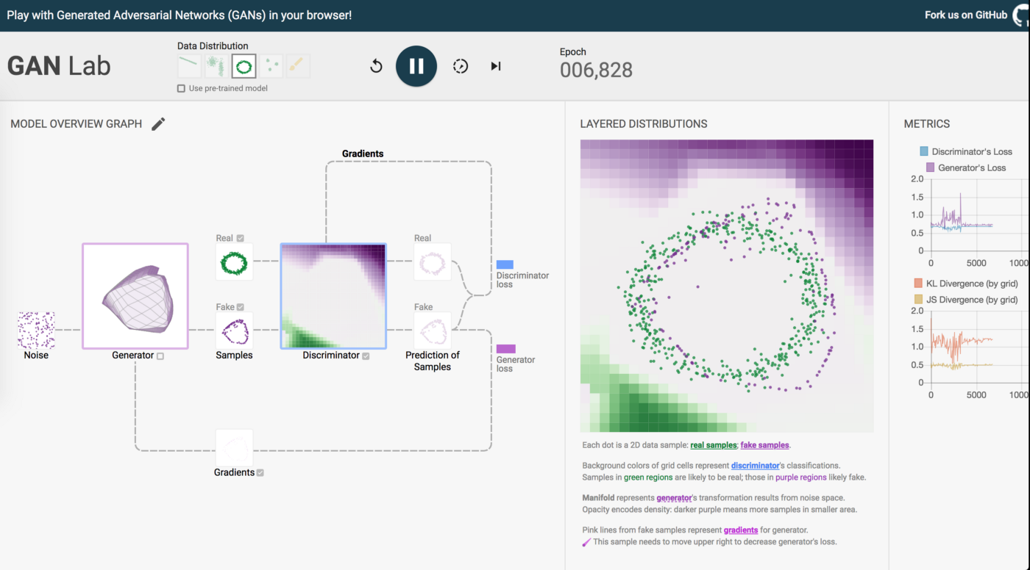
GAN Schema / GAN Lab
GAN Lab - Train GANs in browser, TF based
https://poloclub.github.io/ganlab/
https://towardsdatascience.com/explained-a-style-based-generator-architecture-for-gans-generating-and-tuning-realistic-6cb2be0f431

Slide 5
Make ML Work - Ian Goodfellow@ICLR 2019
Generative Models
Sample Generation (Face Generation - GAN to BigGAN)
Image Translation (Unsupervised - CGAN - pix2pix, CycleGAN)
Video to Video Synthesis (vid2vid, Everybody Dance Now)
Photorealistic Expression (GauGAN, SPADE)
GANufacturing (Physical 3D printed dental crown)
New area - GANs for Fashion
Security (Adversarial training for robust classifiers)
Model-based Optimization (Design DNA to optimize protein)
Reinforcement Learning (Self-Play)
Extreme Reliability (Robustness - Air traffic control, Surgery robot)
Label efficiency (Multiple outcomes from discriminator)
Domain Adoption (Person ReID, Eye samples, Robots training, Sim - Real)
Fairness, Accountability and Transparency (Improving interpretability)
Neuroscience (More understanding of how brain works)
https://www.youtube.com/watch?v=sucqskXRkss

Slide 6
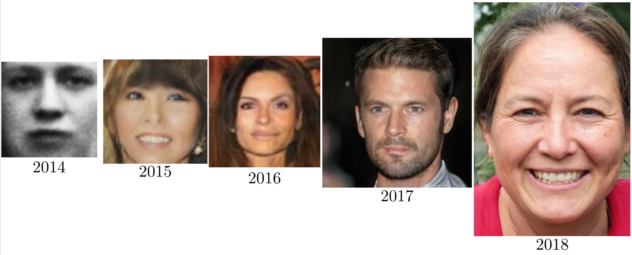
GAN Progress on Face Generation
GAN DCGAN CoGAN ProGAN StyleGAN
Checkout - This Person Does Not Exist
https://twitter.com/goodfellow_ian/status/1084973596236144640?lang=en

Slide 7
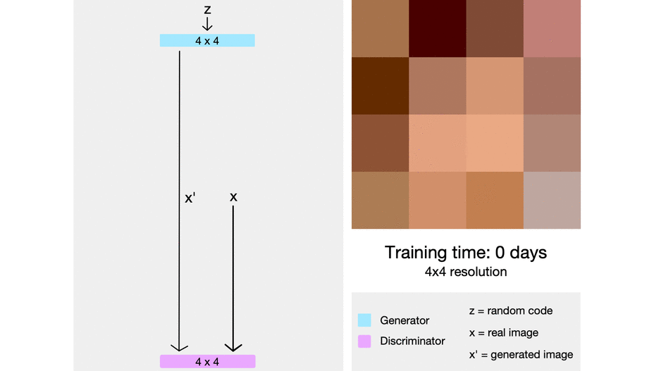
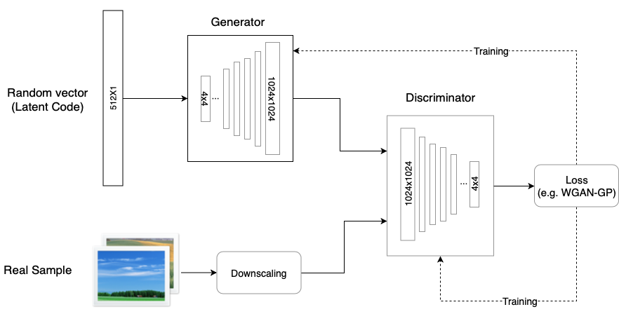
ProGAN
Breakthrough with NVIDIA’s ProGAN progressive training – it starts by training the generator and the discriminator with a very low resolution image (e.g. 4×4) and adds a higher resolution layer every time [0 to 14 days for 1024x1024]
https://towardsdatascience.com/progan-how-nvidia-generated-images-of-unprecedented-quality-51c98ec2cbd2

Slide 8
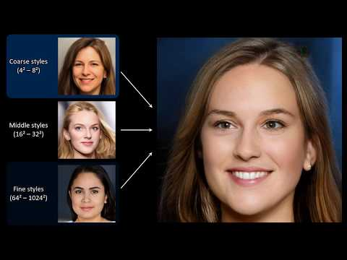
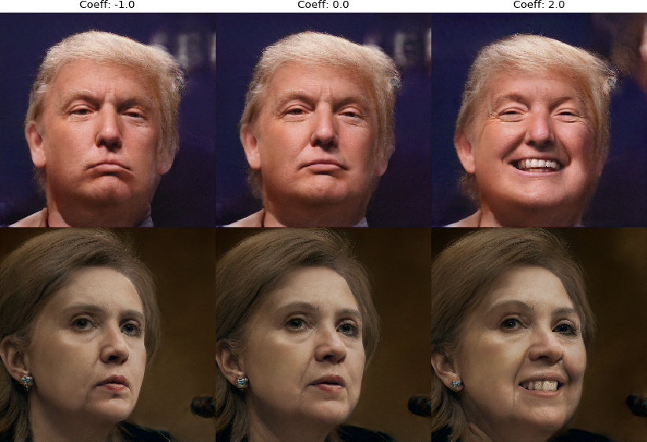
StyleGAN
technique for generating high quality, realistic images. Control different visual features of the image based on resolution
Face Generation -
Coarse – resolution of up to 8x8 – affects pose, general hair style, face shape etc
Middle – resolution of 16x16 to 32x32 – affects finer facial features, hair style, eyes open/closed, etc.
Fine – resolution of 64x64 to 1024x1024 – affects color scheme (eye, hair and skin) & micro features.
StyleGAN Encoder
https://www.lyrn.ai/2018/12/26/a-style-based-generator-architecture-for-generative-adversarial-networks/

Slide 9
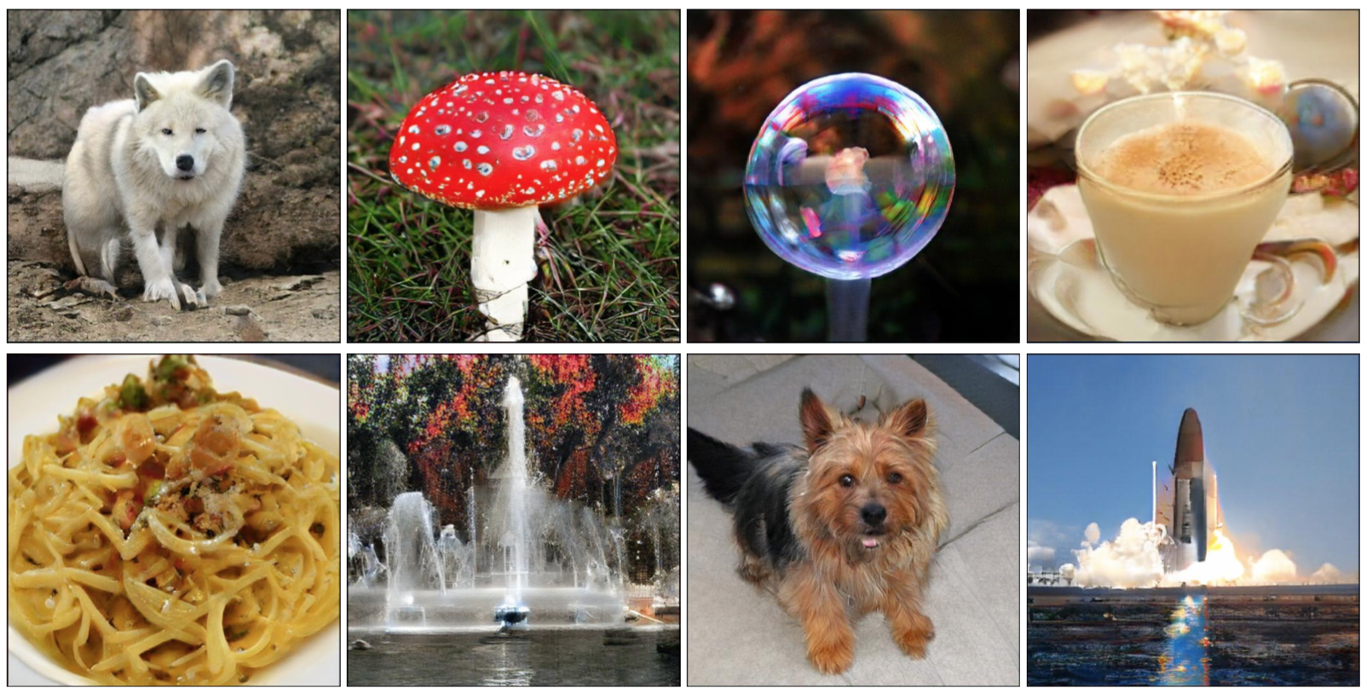
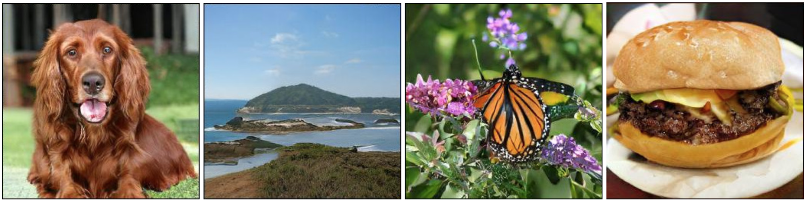
BigGAN
Training GAN on large scale (JFT-300 300 M ImageNet like database of images) on TFU cluster.
BigGAN could do what ProGAN thought would require multi-scale approach in single-scale by using different techniques - truncation trick, ResNet bottleneck, careful experimentation.
BigGAN completely obliterates the previous state of the art Inception score of 52.52 with a whopping score of 152.8.
https://arxiv.org/abs/1809.11096v2, https://blog.floydhub.com/gans-story-so-far/

Slide 10
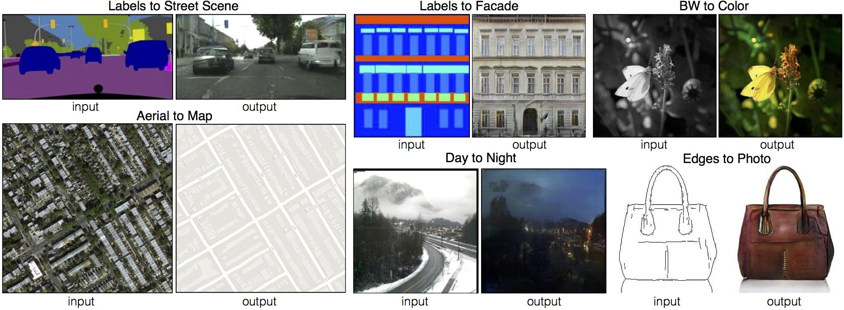
pix2pix - Conditional GAN
https://github.com/phillipi/pix2pix

Slide 11

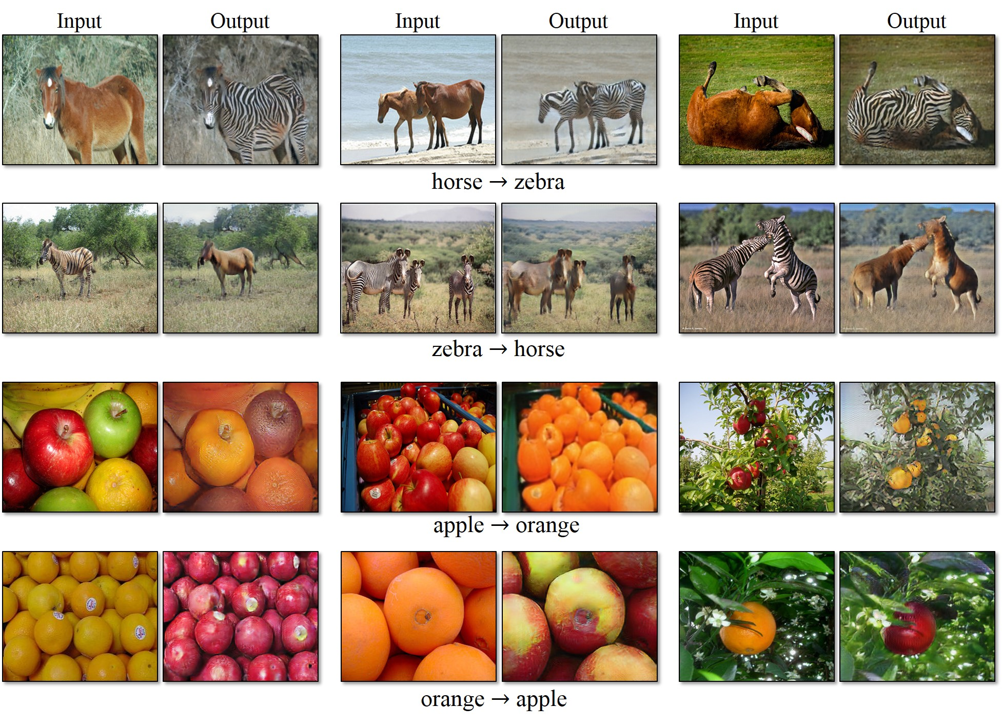
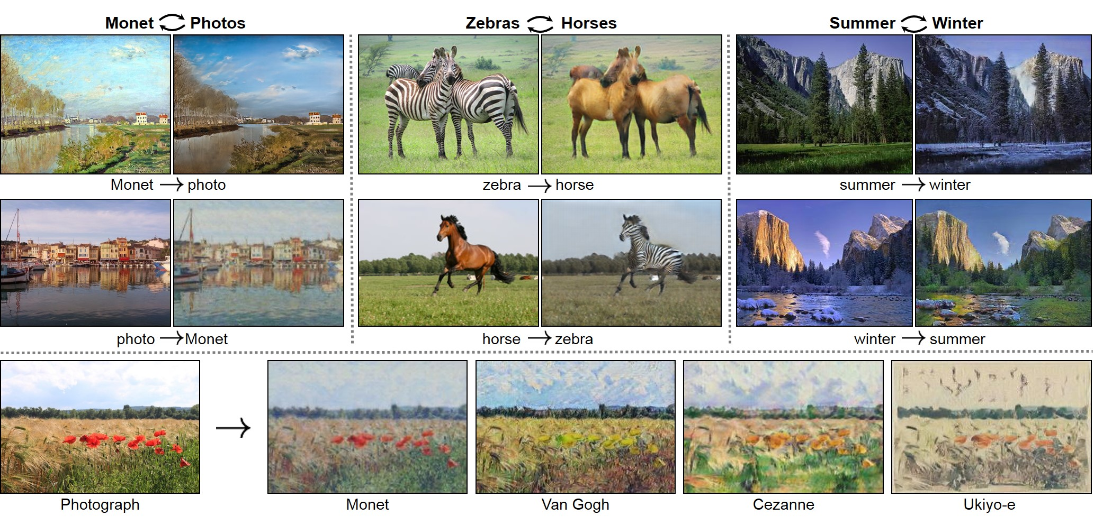
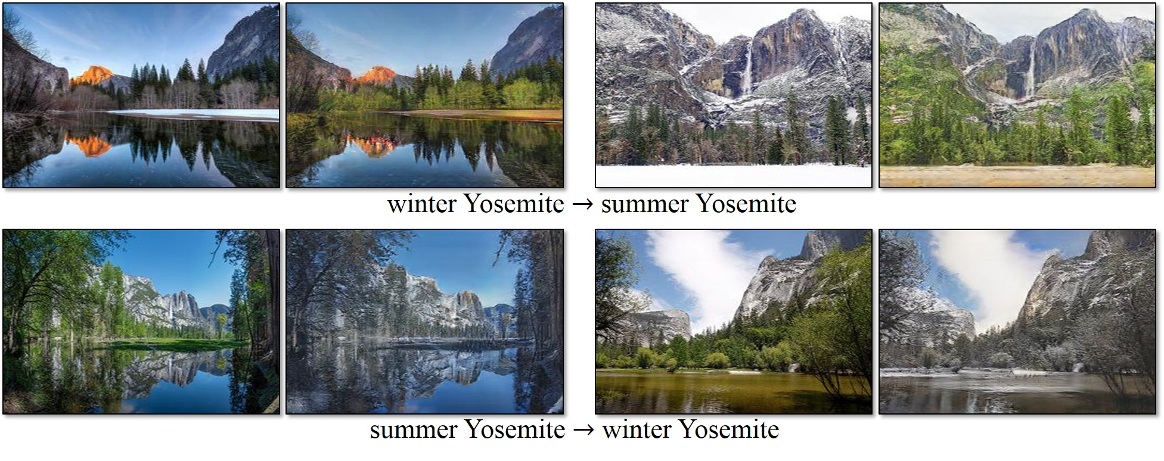
CycleGAN - Image to Image Translation
Uses double mapping i.e. two-step transformation of source domain image - first by trying to map it to target domain and then back to the original image. Hence, we don’t need to explicitly give target domain image
https://github.com/junyanz/CycleGAN

Slide 12
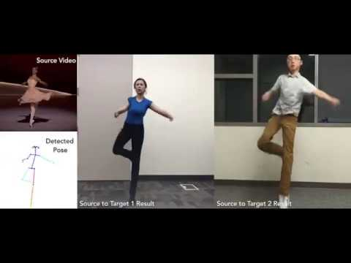
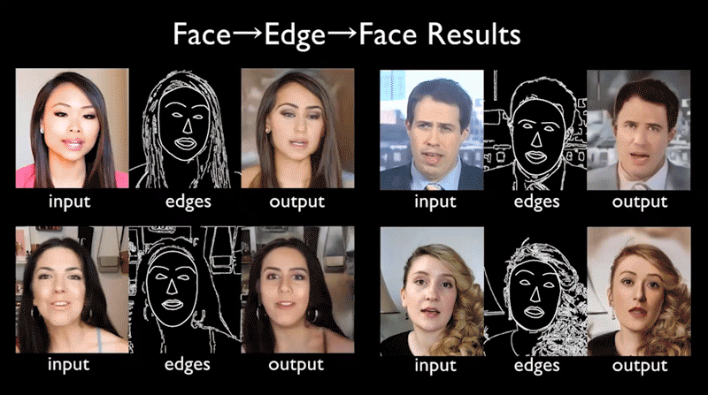
vid2vid - Everybody Dance Now!
https://github.com/NVIDIA/vid2vid

Slide 13
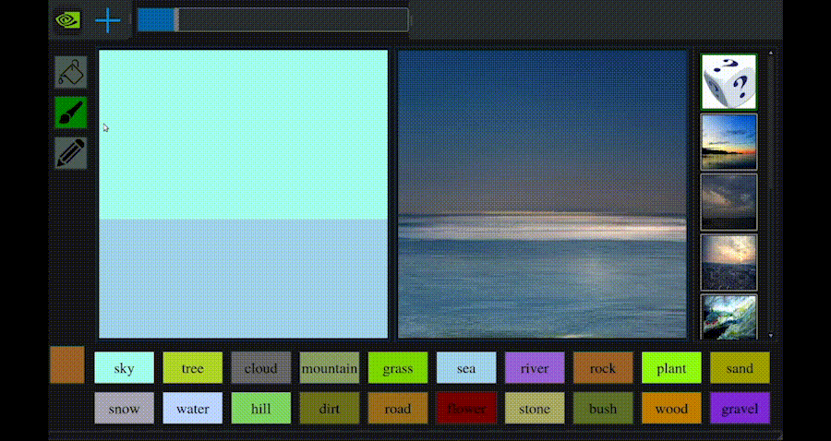
Doodles to Photorealistic Landscapes
GauGAN could offer a powerful tool for creating virtual worlds to everyone from architects and urban planners to landscape designers and game developers.
http://nvidia-research-mingyuliu.com/gaugan

Slide 14
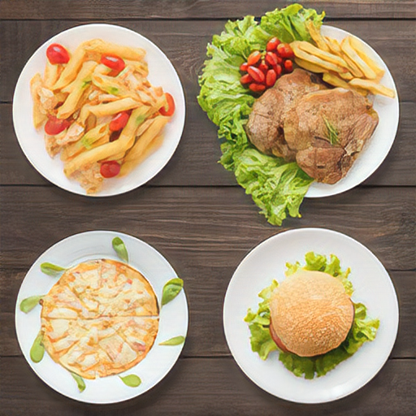

Image Super Resolution (ISR - ESRGAN)
Before - 256x256
https://www.cityofhope.org/image/meals-256x256.jpg
After -512x512
https://github.com/idealo/image-super-resolution

Slide 15
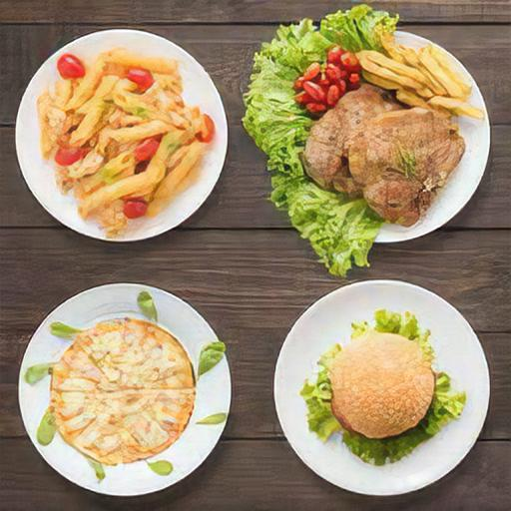

Image Super Resolution (ESRGAN)
Before - Compressed
256x256
After- 512x512

Slide 16
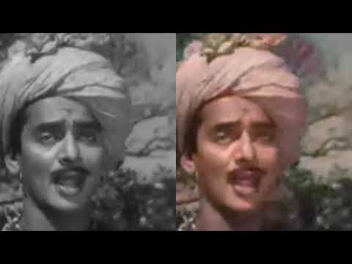
Colorize & Restore old Images and Videos (NoGAN)
https://github.com/jantic/DeOldify

Slide 17
Thank You!

Slide 18
GAN Architectures
Vanilla GAN
Conditional GAN (CGAN)
Deep Convolutional GAN (DCGAN)
Laplacian Pyramid GAN (LAPGAN)
Wasserstein GAN (WGAN)
Super Resolution GAN (SRGAN) -
Progressive GAN (ProGAN)
StyleGAN
Everybody Dance Now
PetSwap
BigGAN
https://www.geeksforgeeks.org/generative-adversarial-network-gan/

